Slide 1
Software Systems Design and Integration
Week 3b
Data Serialization
1-<number>

Slide 2
Lecture Plan
    Internal vs. External Data representation
    in Distributed Systems
      Information and Data Representation
      Marshalling and Un-marshalling
      How it works
    Internal Data Representation
    External Data Representation
1-<number>

Slide 3
Information and Data Representation
Information processed by the programs is represented internally as data structures (primitive values, structured data and data collections).
  The different parts of the distributed system must have identical interpretation of the data representation of the same information across the locations
Data transmitted on the network is always in binary format (sequence of datagrams in UDP, streams of packets in TCP)
  The data structures must be flattened, i.e. converted to sequence of bytes before transmission
  There should be a mapping between the internal and the external data representation so that the data can be rebuilt upon arrival
1-<number>

Slide 4
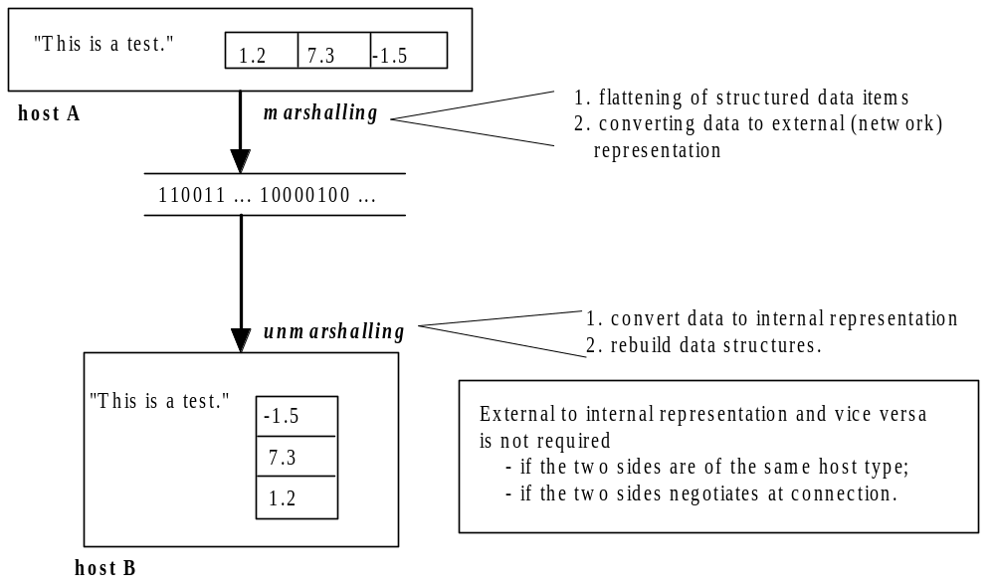
How it works in the simplest case
1-<number>

Slide 5
Serialization and Deserialization
Problem: How to preserve the original data specification in more complex cases?
  This problem occurs because the data is compliant with the data specification at the sender side, but this specification may not be available at the recipient side
Solution: Using additional information about the structure of the transported data
  As a result the data which is sent is not identical to the data which is received (it is serialized)
  Upon receiving the data the original data is restored (deserialized)
1-<number>

Slide 6
Marshalling & Un-marshalling
Marshalling is the process of taking a collection of data items and putting them into a form suitable for transmission in a message.
Marshalling translates structured and primitive values into a suitable external data representation, preserving their identification and characteristics.
Un-marshalling is the process of disassembling messages on arrival to produce an equivalent collection of data sent at the destination.
  Un-marshalling generates primitive and structured values from their external data representation and then rebuilding them into internal data structures.
1-<number>

Slide 7
Lecture Plan
    Internal vs. External Data representation in
    Distributed Systems
    Internal Data Representation
      Methods for Data Representation
      Binary Representation
      Binary vs. Unicode
    External Data Representation
1-<number>

Slide 8
Methods for Information Representation
Different ways to represent the information
  Value-based coding (i.e., 2 bytes for integers, 4 bytes for long integers, 4 bytes for single precision floating point, 8 bytes for double precision, etc.)
  Character-based coding (i.e., 7 bits per character in ASCII, 1 byte in UTF-8, 2 bytes in Unicode, etc.)
Different procedures to map the information
  Using standard mapping – automatic marshalling before sending and unmarshaling before receiving
  Using agreed mapping - Sender sends the format, receivers translates it back into the original format
1-<number>

Slide 9
Binary Representation
Consider the program fragment
int j = 3;
What does it look like in memory (internal representation)?
00000000000000000000000000000011
How could we write it to the wire?
Small-Endian approach: Big-Endian Approach:
1st byte: 00000011 1st byte: 0000000
2nd byte: 00000000 2nd byte: 0000000
3rd byte: 00000000 3rd byte: 0000000
4th byte: 00000000 4th byte: 0000011
The receiver must know which one is used by the sender!
1-<number>

Slide 10
Binary vs. Text-based
Consider the same code fragment
int j = 3;
We could have represented it in Unicode instead (16 bits per each character)
  The character ‘3’ is coded as 0000000000110011
  The character ‘j’ is coded as 0000001110101001
Each method has its own advantages
  Binary is better for arithmetic, hence for numerical data processing
  Unicode does not distinguish digits from text characters, hence in text processing
The receiver better know which one is used by the sender!
1-<number>

Slide 11
Lecture Plan
    Internal vs. External Data representation in
    Distributed Systems
    Internal Data Representation
    External Data Representation
      SUN's External Data Representation
      CORBA's Common Data Representation
      Java's Object Serialization
      Hypertext Formats
      Text Encoding Formats
1-<number>

Slide 12
Popular Formats
Some external data representation formats
    SUN's External data representation (XDR)
    CORBA's Common Data Representation (CDR)
    Java's Object Serialization (RMI);
    Extendable Meta Language (XML)
    Java Script Object Notation (JSON)
    Comma-separated values (CSV)
    Plain Text encoding (UTF-8 or Unicode)
1-<number>

Slide 13

External Data Representation in CORBA
Can be used to exchange data between any CORBA –
compatible components of distributed applications
written in different languages
  Serializes both primitive and complex data types
Supports 15 different primitive types: short, long ...
  support both big-endian and little-endian
  transmitted in sender's ordering and ordering is
  specified
  receiver translates it back if needed
Can be used to exchange data between CORBA –compatible components of distributed applications written in different languages
1-<number>

Slide 14
CORBA Data Types
Structured types are represented using 4-byte blocks
    A sequence of blocks representing each data
    The size of each block is represented
    The blocks are indexed for easy access
Type | Representation
sequence | length (unsigned long) followed by elements in order
string | length (unsigned long) followed by characters in order
array | elements in order (no length specified because it is fixed)
struct | elements in order of specification of the components
enumerated | unsigned long (the values are specified in the order of declaration)
union | type tag followed by the selected member of the union
1-<number>

Slide 15
Example: CORBA representation of personal information
index in the
content
representation
sequence of bytes
(4 bytes)
0–3
5
length of string
4–7
"Smit"
first part
8–11
"h___"
second part
12–15
6
length of string
16–19
"Lond"
first part
20-23
"on__"
second part
24–27
34
unsigned long
The flattened form represents a Person structure with
attribute values {‘Smith’,‘London’,34}
1-<number>

Slide 16
Remote Object Reference (EDR)
Calling methods of a remote object requires unique reference to it in the whole distributed system
  Reference = IP address + port + creation time + local object reference + remote object interface
  Port + process creation time -> unique process
  Address can be derived from the reference through the local object reference and the remote interface
Objects usually don't move; if they move their location can still be found – how?
32 bits
32 bits
32 bits
32 bits
32 bits
Internet
address
TCP/IP port
number
time
object
number
interface of
remote object
1-<number>

Slide 17
External Data Representation in Java
Java implements marshalling and unmarshalling automatically as serialization and deserialization of the values of serializable data types
Used for marshalling and unmarshalling of arguments and return values of the remote method invocations in RMI-based distributed systems
Serialized data can be transmitted over IIOP or stored as object values in files
  write class information, types and names of instance variables into the values
  recursively writes class information, types, names for all object types referred to within objects
  each class has a handle for subsequent references
  values are in Universal Transfer Format (UTF)
1-<number>

Slide 18
Representing Object References
References to other objects
  other objects should be serialized as well
  the references are serialized as handles, so that
    each object is written only once
    second or subsequent occurrence of the object is written as a handle
References to the current object (reflection)
  When asking about the properties (name, types, methods) of a class in this
  uses relative addressing
This helps with serialization and deserialization!
1-<number>

Slide 19
Example: Serialization
public class Person implements Serializable {
private String name;
private String place;
private int age;
public Person(String aName,String aPlace,int anAge){
name = aName;
place = aPlace;
age= anAge;
}
}
Serialized values
1 Person
2 <8-byte version number>
h0
3
int
age
java.lang.String
java.lang.String
name
place
4 34
5 Smith
6 London
h1
The true serialized form contains additional type markers; h0 and h1 here are handles of objects (strings by default)
1-<number>

Slide 20
External Data Representation in XML
EXtensible Markup Language
  User-defined tags (vs. HTML with fixed set of tags)
  Different applications may agree on a different set of tags (i.e., HTML has an interpretation specified by a separate CSS or fixed by the Web browser, plain XML has interpretation given by XML Schema or DTD, while in SOAP the Web Services tags are published in a separate WSDL specification)
  Tags are in plain text (not binary format), therefore can be transported easily but are not space efficient
1-<number>

Slide 21
Example: XML representation of personal information
The internal Person object can be represented externally using XML
  Tag names: person, name, place, year
  Elements: <name>Smith</name>
  Attributes: id=123456789
XML is a text format, so binary data needs to be converted to characters (using base64 format)
<person id=123456789>
<name>Damon</name>
<family>Smith</family>
<place>London</place>
<age>21</age>
<!– too young, too stupid – a comment -->
</person>
1-<number>

Slide 22
XML Namespaces for tagging
Name clashes within XML due to the multiple possible aliases of the same name
The XML Namespaces allow to prefix the names so that they can be interpreted in a unified manner
  Tag xmlns tag within the XML has predefined meaning and specifies the namespace of the tags using in the XML
  Each namespace is a set of names for a collection of element types and attributes to be used across applications, typically it stored as XML Schema files on the Internet
Unlimited number of namespaces can be used within the same XML
1-<number>

Slide 23
XML Schema for Complex Data Types
Each XML Schema defines a new namespace together with its interpretation
Similar to type definition which specifies attributes
Namespace xsd is reserved for specifying the XML Schema definitions themselves
<xsd:schema xmlns:xsd = URL of the standard XML schema definition>
<xsd:complexType name="personType">
<xsd:sequence>
<xsd:element name="firstName" type= xs:string/>
<xsd:element name="lastName" type= xs:string/>
<xsd:element name="age" type= xs:positiveInteger/>
</xsd:sequence>
<xsd:attribute name="id" type = xs:positiveInteger/>
</xsd:complexType>
<xsd:element name="person" type = personType />
</xsd:schema>
1-<number>

Slide 24
Object referencing
Simply by prefixed name, which unambiguously points at a single XML element
Possible use of the ID of an element within the same context (more efficient)
Using XML referencing specifications (Xpointer, Xlink,Xpath)
1-<number>

Slide 25
External representation using JSON
JSON stands for JavaScript Object Notation
JSON is a text format for representing objects as named value pairs
Essentially an object-relational format which is simpler than XML and more economical
  Objects with attributes
  Complex object values
  Arrays of objects
processed by RESTful Web Services and stored in different databases

Slide 26
JSON
  Popular amongst JavaScript programmers as a replacement of XML in AJAX applications
    JSON objects can encapsulate data easily, so direct mapping of object data types
    JSON objects can be transported across the network using text-based protocols such as HTTP
  Can be used on the server side as well
    JSON objects can be processed by the server app (supported by all RESTful Web services)
    JSON objects can be stored directly inside some SQL and non-SQL databases – i.e., Mongo DB
  Most of the programming languages have JSON API (PHP, Java, .Net, Python)
1-<number>

Slide 27
Example: Representing a serialized object in JSON format
{
"firstName": "John",
"lastName": "Smith",
"age": 25,
"address": {
"streetAddress": "21 2nd Street",
"city": "New York",
"state": "NY",
"postalCode": 10021
},
"phoneNumbers": [
{
"type": "home",
"number": "212 555-1234"
},
{
"type": "fax",
"number": "646 555-4567"
}
]
}

Slide 28
Other Formats
Comma Separated Values (CSV)
  Standard format for exporting data from databases, supported by many spreadsheets as well
  Used in information systems for visualization and reporting of data stored in SQL databases, and in data analytics for exchanging data between the modules for data processing in a streamlined architectures of the applications
  No referencing …
Plain text format
1-<number>

Slide 29
Lecture Summary
  What we have covered in this topic:
  External Data Representation
  Next week we will cover:
  Client/server Development
  Multi-threading
1-<number>

